Slide 1
Docker
DevOps Training
Shriniwas Mujumdar
Sagar Joshi
Yogendra Vyas

Slide 2
Before Start ?

Slide 3


User Concern
It’s Working for Me…………
Why Not for Me????????

Slide 4
Why Not Working
Environment is not Same
Hardware dependency
OS dependency
Software Dependency
Missing Environment Variable
Not started as it should be
Missing required files
Application Version mismatch

Slide 5
Software Packaging
required to run a module
Software application
Operation System
Libraries
Environment variable
Etc…
Run anywhere

Slide 6
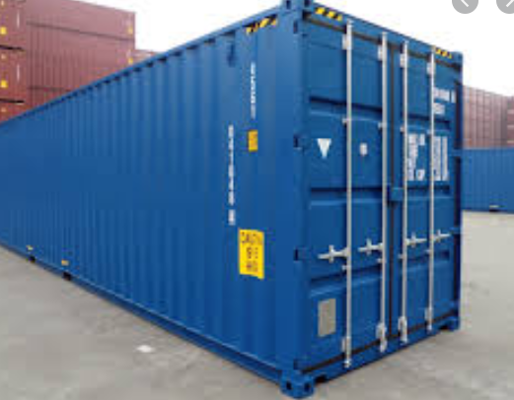
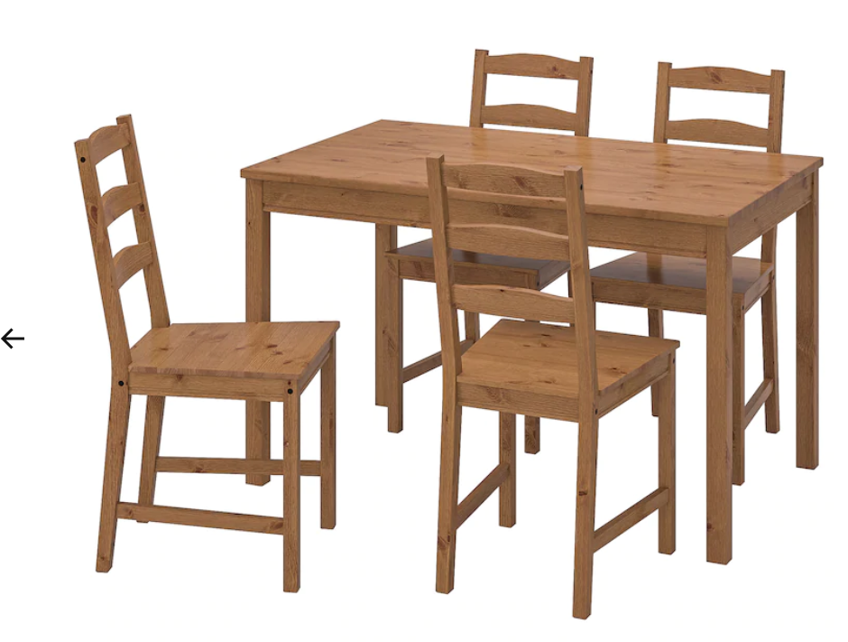

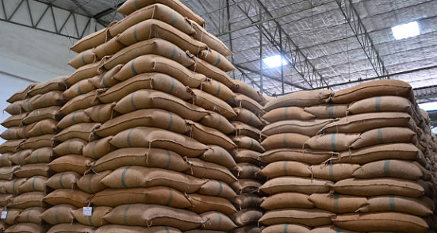
Why Container
Some Items are big
Some Items are Small
Some Items are hard
Some Items are fragile
Some Items have Shape
Some Items have no Shape
Some are liquid

Slide 7
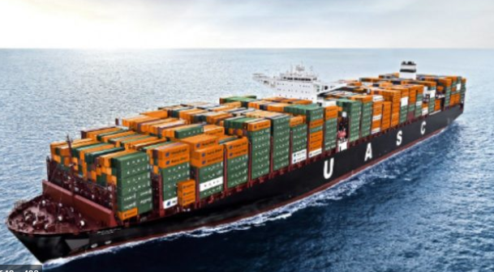
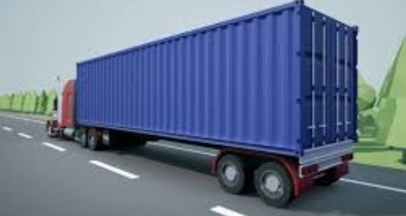
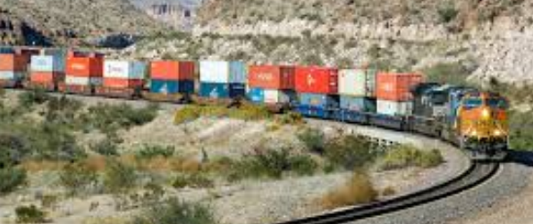
It can transport any where.

Slide 8
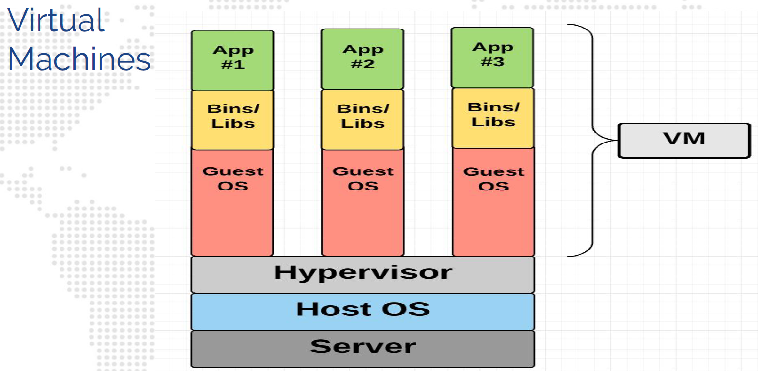
Virtual Machines

Slide 9
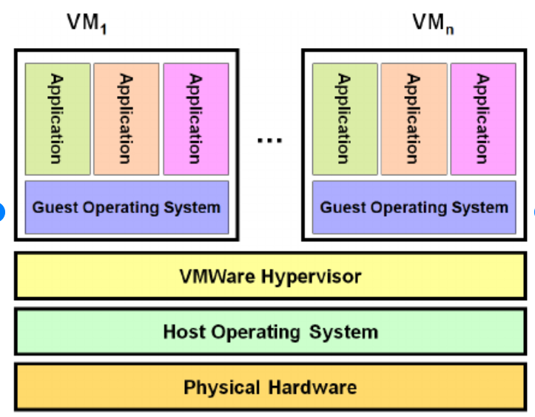
Virtualization Benefit
Easy to Manage Hardware Resource
Infrastructure
Energy Saving
Cost Effective
Maximum Utilization of available resources
Allocation of resources as per requirement
Install what you need

Slide 10
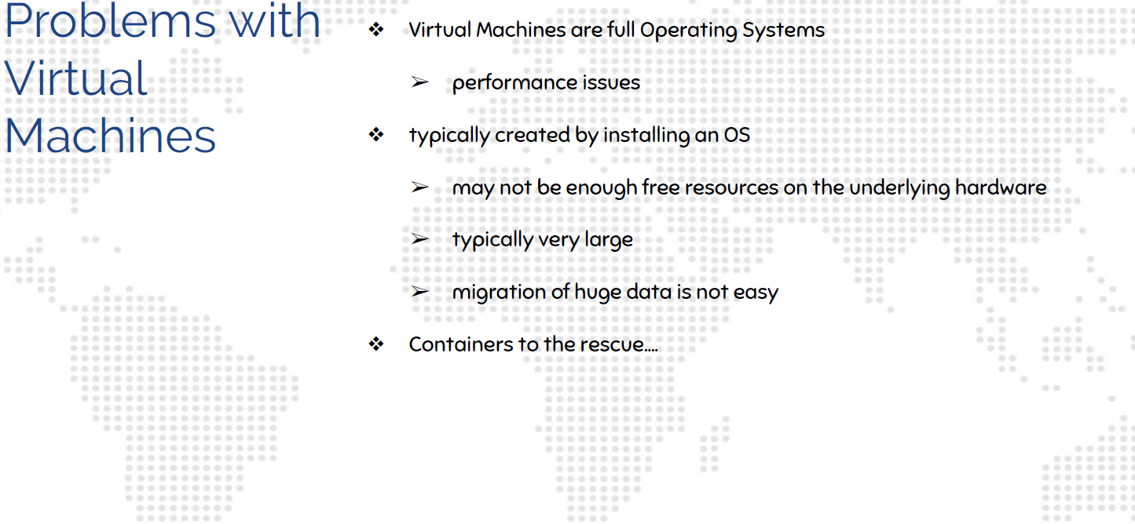
Problems with VMs

Slide 11
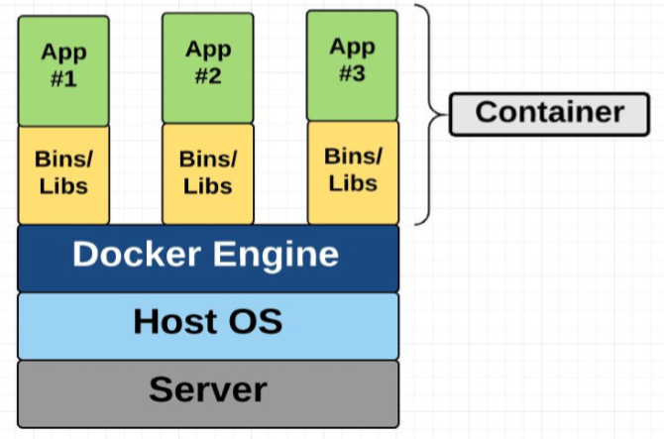
Containers
A container is a standard unit of software that packages up code and all its dependencies, so the application runs quickly and reliably from one computing environment to another.

Slide 12
Advantages of Containers
Quick Startup
Isolation
Agility
Scalability
Portability
Maintainability
Versioning

Slide 13
Containers Vs Virtual Machine
Virtual machine is virtualization on hardware however Containerization is on Operating system
Security
Sb ize
Fast booting time
Easy data sharing across multiple containers

Slide 14
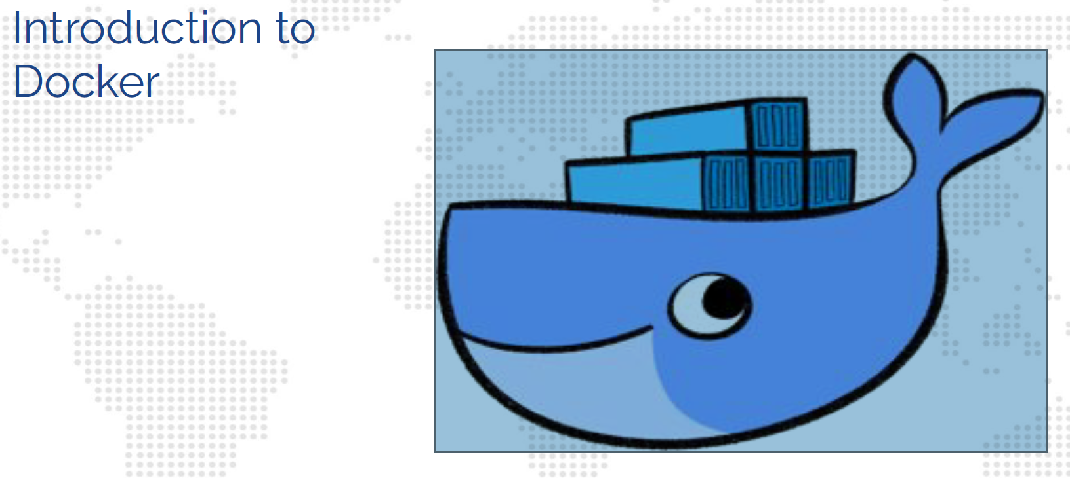
Introduction

Slide 15
What is Docker?
Docker Inc.
Docker (Dock Worker)
dotCloud
Startup in Bay area
Rolled out Docker since 2013
Docker Technology
Open source
GitHub
Written in Go Language
Running applications inside Container easily

Slide 16
Docker Editions
Docker CE (Community Edition)
Open Source
Lot of Contributors
Fast Release Cycle
Docker EE (Enterprise Edition)
Slower Release Cycle
Official Support

Slide 17
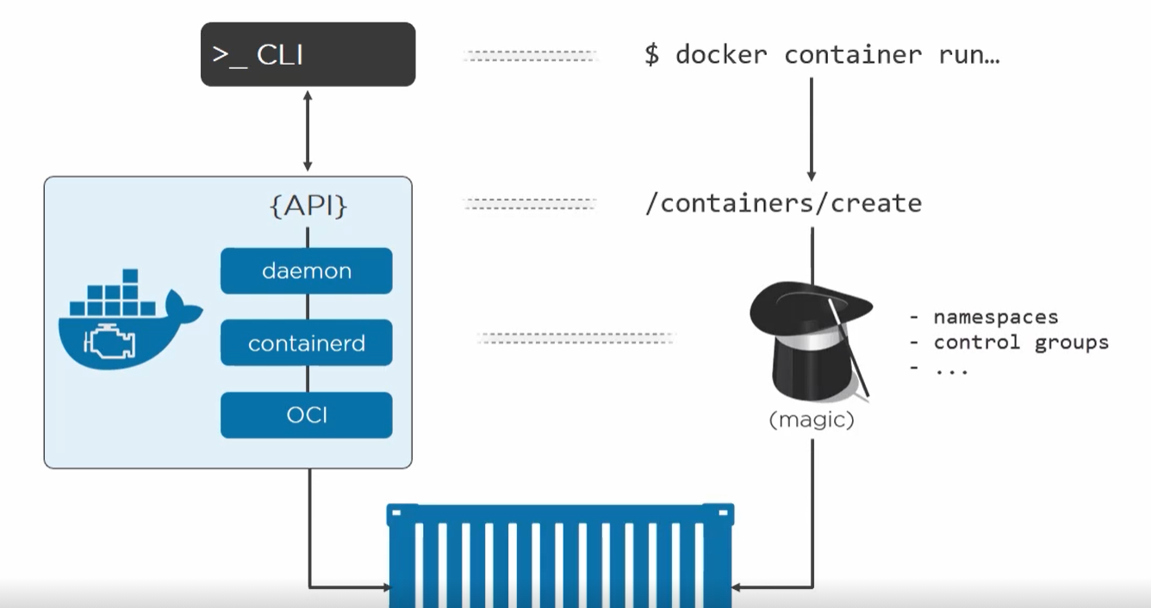
Docker Core Components
Core Components
Docker Daemon
Docker Engine, runs on a host machine
Docker Client
CLI used to interact with Daemon

Slide 18
Docker Workflow Components
Docker Workflow Components
Docker Image
Docker Container
Docker Registry

Slide 19
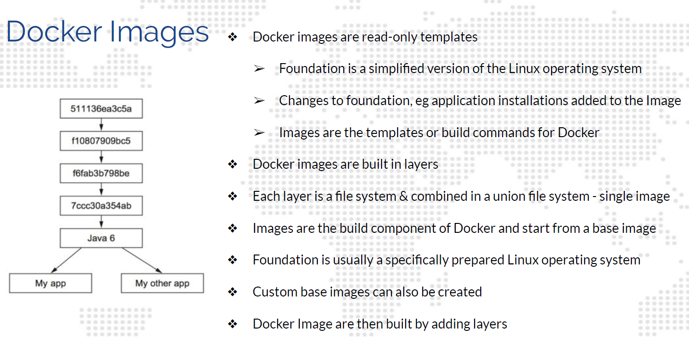

Slide 20
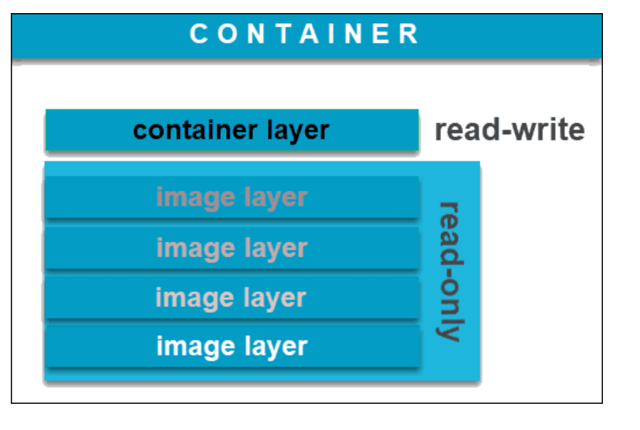
Docker container
A Docker container is a virtualized run-time environment where users can isolate applications from the underlying system. These containers are compact, portable units in which you can start up an application quickly and easily.
A container only has the bare minimum software required to run an application, making it an efficient approach to running applications.

Slide 21
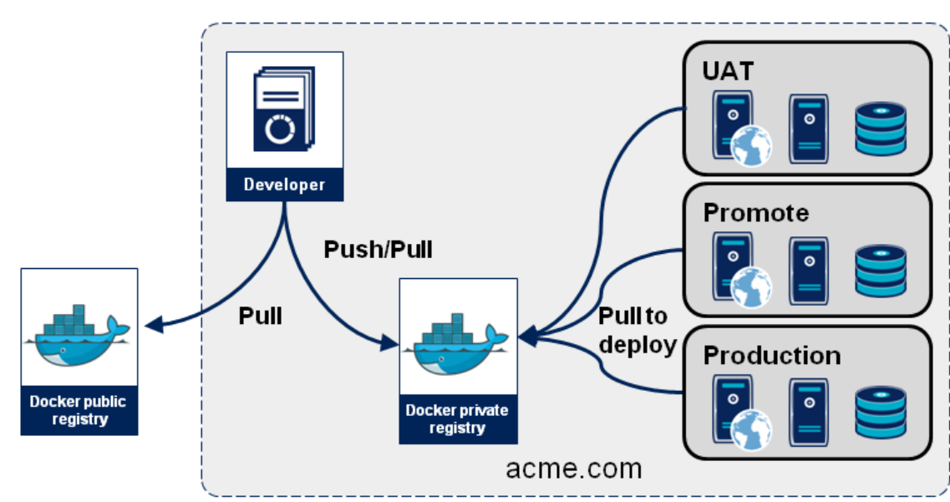
Docker Repository
https://hub.docker.com/
Docker Image Repository
pull from registry
push into registry
Download Image
Run as Container
Create your own Docker image from existing images (using Dockerfile)
JFrog Repository for FIS

Slide 22
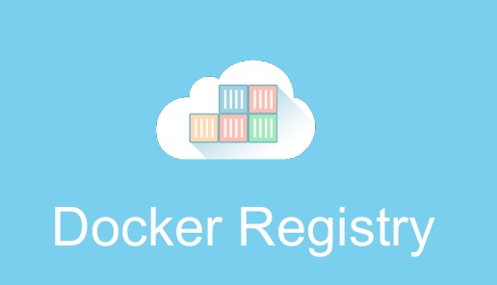
Docker System
Images
Containers – start stop restart
Server
DockerFile
Build
i1
i2
i3
c1
c2
c3

Slide 23
Installing Docker
sudo free –h
sudo yum update -y
sudo yum install -y yum-utils
sudo yum remove docker docker-client docker-client-latest docker-common docker-latest docker-latest-logrotate docker-logrotate docker-engine
sudo yum-config-manager --add-repo https://download.docker.com/linux/centos/docker-ce.repo
cd /etc/yum.repos.d
ls -l

Slide 24
Installing Docker
yum install docker-ce docker-ce-cli containerd.io --nobest –y
docker –version
Checks Docker version
ps –ef|grep docker
Check if docker process is active

Slide 25
Mission : Start Docker
systemctl start docker
systemctl status docker
ps –ef|grep docker
dockerd is a Docker Daemon.

Slide 26
Docker Commands
$docker ps
$docker images
$docker image ls
$docker pull httpd:latest
$docker run –itd httpd
Observe difference between CREATED value for Images vs. Container

Slide 27
Docker Commands
$docker stop <<container id>>
$docker ps
$docker ps -a
Image -> Container (can be One -> Many relationship)
Run $docker run –itd <<image_id>> multiple times.
All Container Ports on 80? What? How is that Possible?
$docker inspect <<container id>>
IP Address same or different?
Exercise : Find out Whether IP Address is same or different for all the containers. List them down as per container id.

Slide 28
Solution – Docker Port Forwarding
$docker images
$docker run –itd –P <<image id>>
$docker ps
Access <<host_ip_address>>:32768, 32768 port is decided by Docker Daemon
e.g. 100.26.160.226:32768
It Works!

Slide 29
Docker Port Forwarding
$docker images
$docker run –itd –p 9191:80 <<image id>>
Exercise – Customize port number as per the above command and test the httpd in browser

Slide 30
Docker Container Names
$docker images
$docker run –itd --name dev-env –p 9192:80 <<image name>>
$docker ps

Slide 31
What is $docker run –itd…?
-i - interactive
-t - terminal
-d - detached
$cat /etc/redhat-release
$docker pull centos
$docker images
$docker run –itd <<image id>>
$docker ps
$docker run –it <<image id>>
$cat /etc/redhat-release
$exit

Slide 32
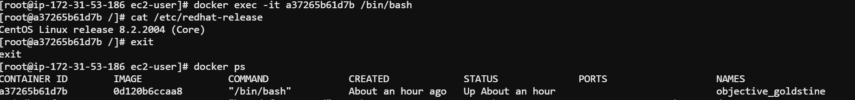
What is $docker run –itd…?
$docker exec –it <<CentOS_Container_ID>> /bin/bash

Slide 33
Docker stats
$docker inspect <<image id>>
Check for ExposedPorts
Some Containers(httpd) show port numbers and some(CentOS) do not
$docker stats

Slide 34
docker cp
Create a html file on host
$docker ps
$docker exec –it <<container id>> /bin/bash
#cd htdocs
#ls
#exit
Copy it to the container
$docker cp sample.html <<container id>>:/usr/local/apache2/htdocs
Check for new html page for the above container

Slide 35
Docker Volumes
Docker volumes are a widely used and useful tool for ensuring data persistence while working in containers. Docker volumes are file systems mounted on Docker containers to preserve data generated by the running container.
The data doesn't persist when that container no longer exists, and it can be difficult to get the data out of the container if another process needs it.
A container's writable layer is tightly coupled to the host machine where the container is running. The data cannot be easily moveable somewhere else.
Writing into a container's writable layer requires a storage driver to manage the filesystem.
$docker volume list
docker volume inspect [volume_name]
docker run --mount source=[volume_name],destination=[path_in_container] [docker_image]
docker volume rm [volume_name]

Slide 36
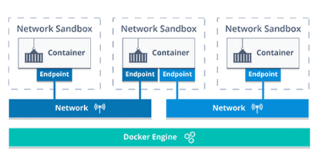
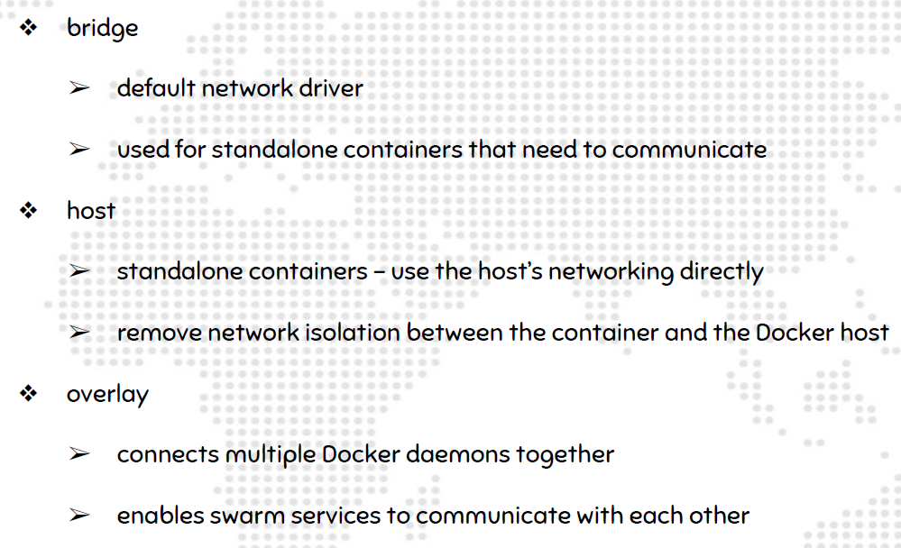
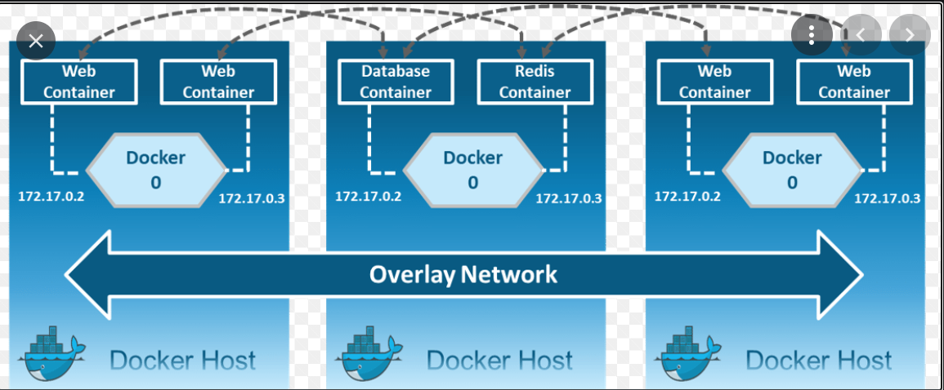
Docker Network

Slide 37
Docker Networks
docker network ls
docker network inspect bridge
docker network create --driver bridge isolated_nw
docker network inspect isolated_nw
docker run –itd --network=isolated_nw --name dev-env –p 9192:80 <<image name>>

Slide 38
Dockerfile
A Dockerfile is a text document that contains all the commands a user could call on the command line to assemble an image.
Keywords should be in uppercase
Instructions can be commands or arguments
e.g.
FROM busybox
MAINTAINER Yogendra
ENTRYPOINT ["/bin/cat"]
CMD ["/etc/passwd"]

Slide 39
Docker File Commands
ADD
➢ Usage: ADD [source directory or URL] [destination directory]
CMD
➢ CMD application "argument", "argument",
ENTRYPOINT
➢ An ENTRYPOINT allows you to configure a container that will run as an executable.
ENV
➢ Usage: ENV key value
EXPOSE
➢ Usage: EXPOSE [port]
FROM
➢ Usage: FROM [image name]
MAINTAINER
➢ Usage: MAINTAINER [name]
USER
➢ Usage: USER [UID]
RUN
➢ Usage: RUN [command]
VOLUME
➢ Usage: VOLUME ["/dir_1", "/dir_2" ..]
WORKDIR
➢ Usage: WORKDIR /path

Slide 40
Pushing image to docker registry
Create an account on hub.docker.com
$docker login
Enter Username/password
$ cat /root/.docker/config.json
Encrypted password
$docker build –t <username>/<repositoryname> .
$docker push shrinivasmujumdar/my_httpd_0209:v1

Slide 41
Docker Compose
Application
Application Server/Web Server
Database
YAML
Scripting
Configurations
docker-compose.yml
Install Docker Compose
Refer https://docs.docker.com/compose/install/ (Use Linux Installation steps)

Slide 42
Docker Compose
Take YAML from docs.docker.com if there are formatting issues
Make necessary changes if needed.
$docker-compose up –d
$docker ps
$docker images
$docker inspect <<mysql container id>>

Slide 43
Docker Compose
Check Mount section in inspect data
$docker inspect <<mysql container id>> > inspect.txt
$docker logs <<container id>>
$docker logs –f <<container id>>

Slide 44
Just Docker is not enough….
Load Balancing
High Availability
Failover Mechanism
Orchestrator
Docker Swarm
Kubernetes (K8S)
OpenShift from Red Hat

Slide 45
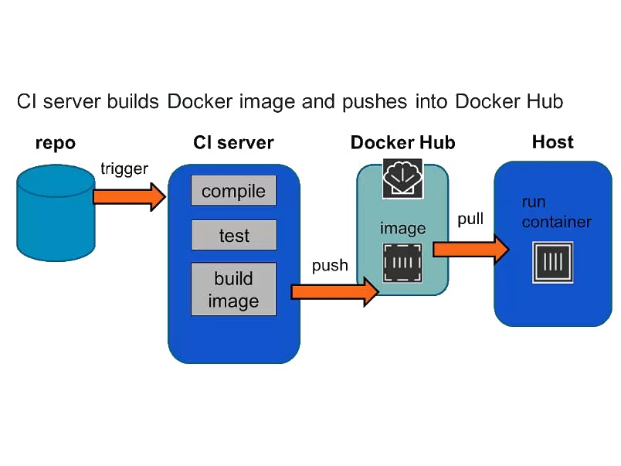
Docker Repository in CI – Big Picture

Slide 46

Thank you !!!

Slide 47
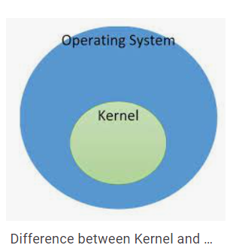
Container Os
Container OS
The kernel is a central project, and is nominally the same in each distro, but most distros customize it a bit.

